Slide 1
Panorama Android App development
Ren Ye, Dec 2020

Slide 2
Objective
Develop an Android panorama app following the given example app
functional requirement:
live view video
real time panorama stitching progress
able to stitch from left side or right side
start/stop button to start/stop panorama image taking
auto stop when reach the width/angle limit

Slide 3
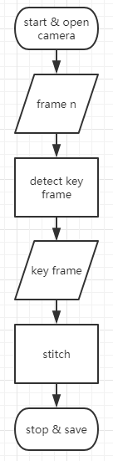
Design
detect key frame by
motion sensor (not available in my device)
OR optical flow (no sweeping angle infomation, hard stop by image width)
stitch
OpenCV stitching API

Slide 4
Available hardware
Huawei media pad S8-701u (Android 4.1 API 16)
Samsung pad A6 (Android 5.0 API 21)
neither have IMU sensor nor compass sensor

Slide 5
Trial 1 (failed)
Using OpenCV Android SDK (v3.4.10) + OpenCV manager (v3.4.10)
Optical flow java API working
stitching API not available in java API, have to compile in JNI (C++) => Trial 2:
change device from Android 4.1 to Android 5.0
use higher OpenCV SDK
use JNI

Slide 6
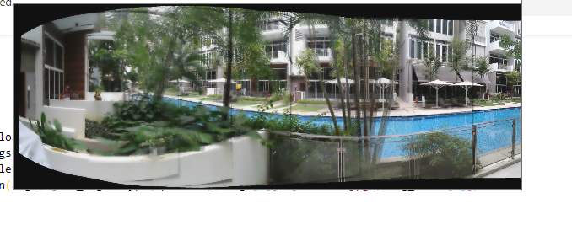
Trial 2: incremental stitching (failed)
OpenCV Android SDK (v4.2.0) + JNI + lib_opencv4.so (eliminate opencv manager)
stitching module working but failed after ~3 key frames

Slide 7
Trial 2 (Optical flow module)
take two nearby frames (e.g. 5 frames apart)
calculate optical flow between the two frames => get flow direction (arctan(dy, dx)) and amplitude (hypot(dx, dy))
direction to determine if the camera is moving to a consistent direction
amplitude to determine if the frames are too near or too far apart
rule of thumb: direction within 2 degree and amplitude around 40 px are considered a key frame

Slide 8
Trial 2 (stitching module)
keyframe_0 and keyframe_1 stitched by cv::stitch() and output as stitched_0
warp: cylindrical, matcher: homography, estimator: homography,
also tried on wave corrector, blender, seam finder, exposure compensator
stitched_0 and keyframe_2 stitched by cv::stitch() and output as stitched_1
stitched_n-1 and keyframe_n stitched and output as stitched_n
However, it failed when n=~3 due to insufficent matching point
and stitched image very blur (due to multiple blending)

Slide 9
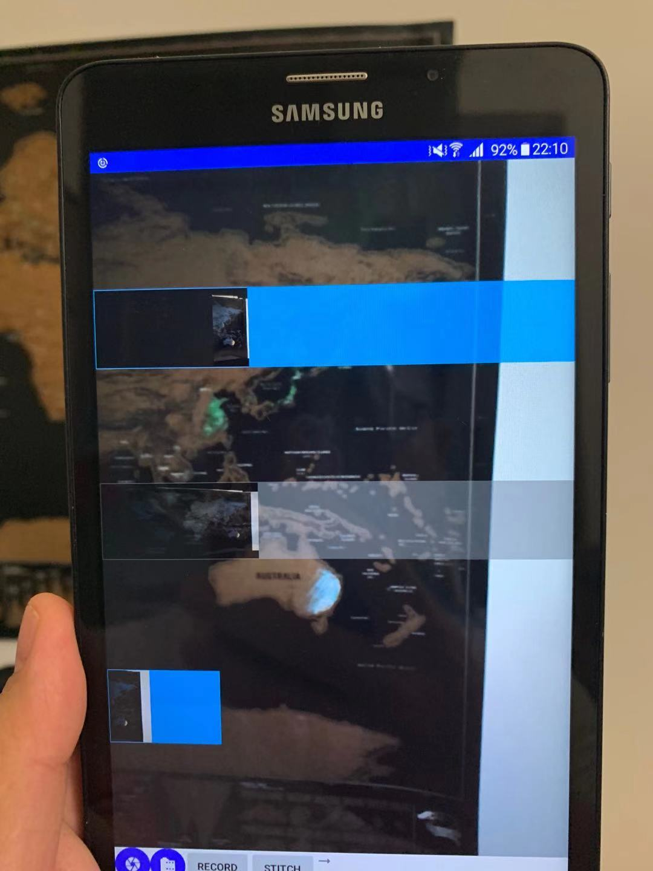
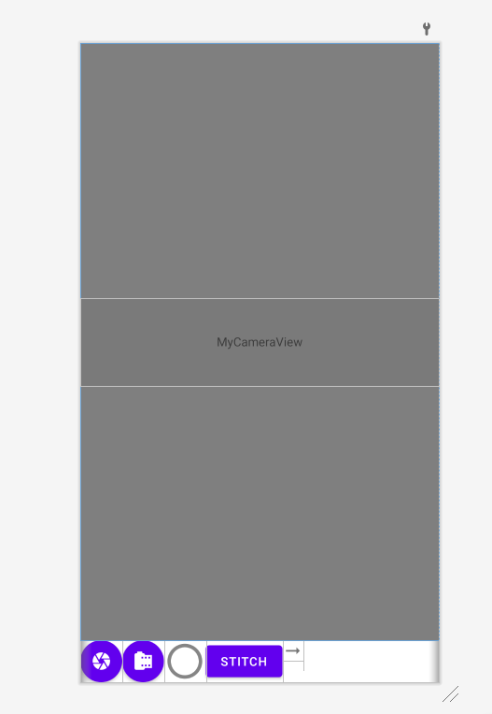
Trial 2 (GUI)
live view
stitched n-1 with mask
stitched n
keyframe n

Slide 10
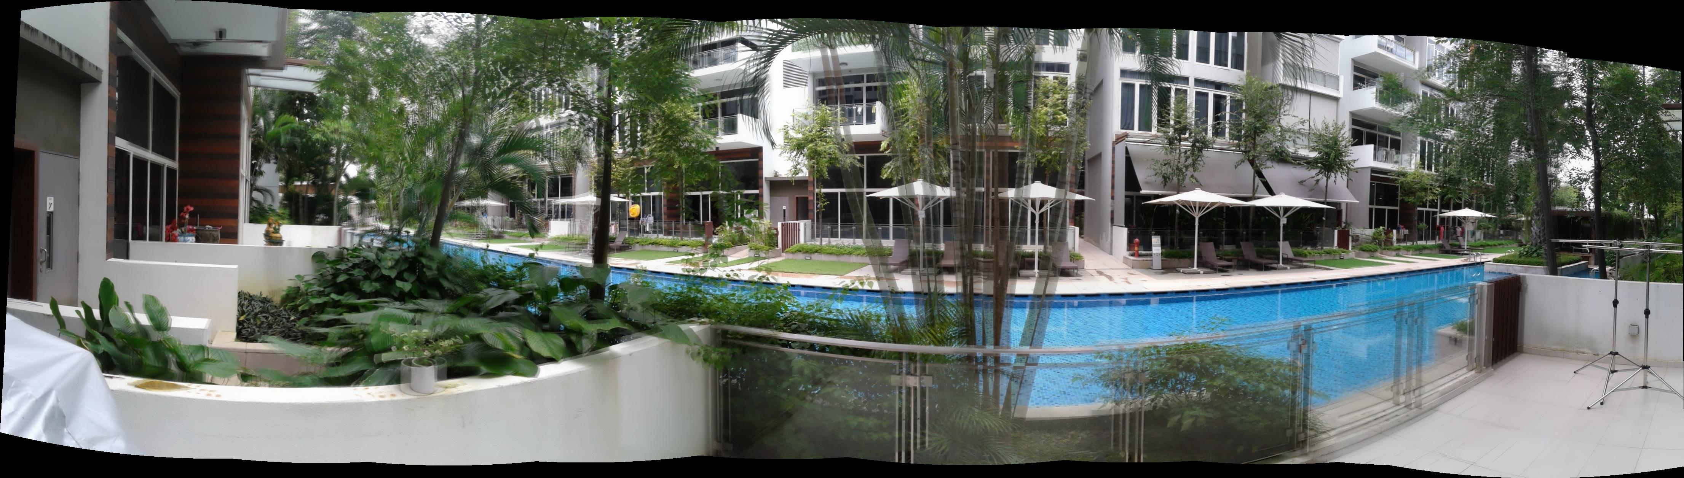
Trial 3 (failed)
rewriting stitching module due to: stitched + key frame will accumulate error and blurry
idea: cache all key frames (kf) and put into stitch module as:
stitch(kf_0, kf_1, kf_2) => display(stitched_2)
stitch(kf_0, kf_1, kf_2, kf_3) => display(stitched_3)
stitch(kf_0, ... kf_n)=> display(stitched_n)
However, it will be too slow when n becomes larger due to pairwise matching in cv::stitch

Slide 11
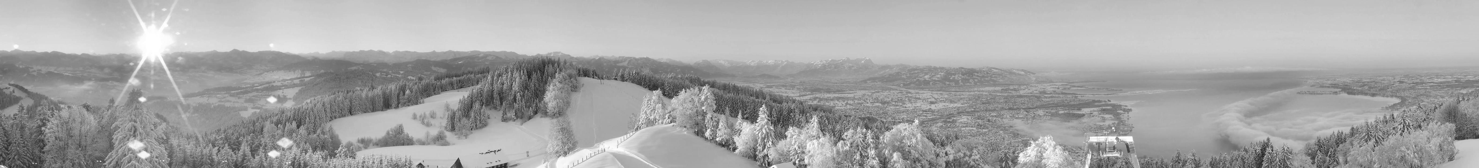
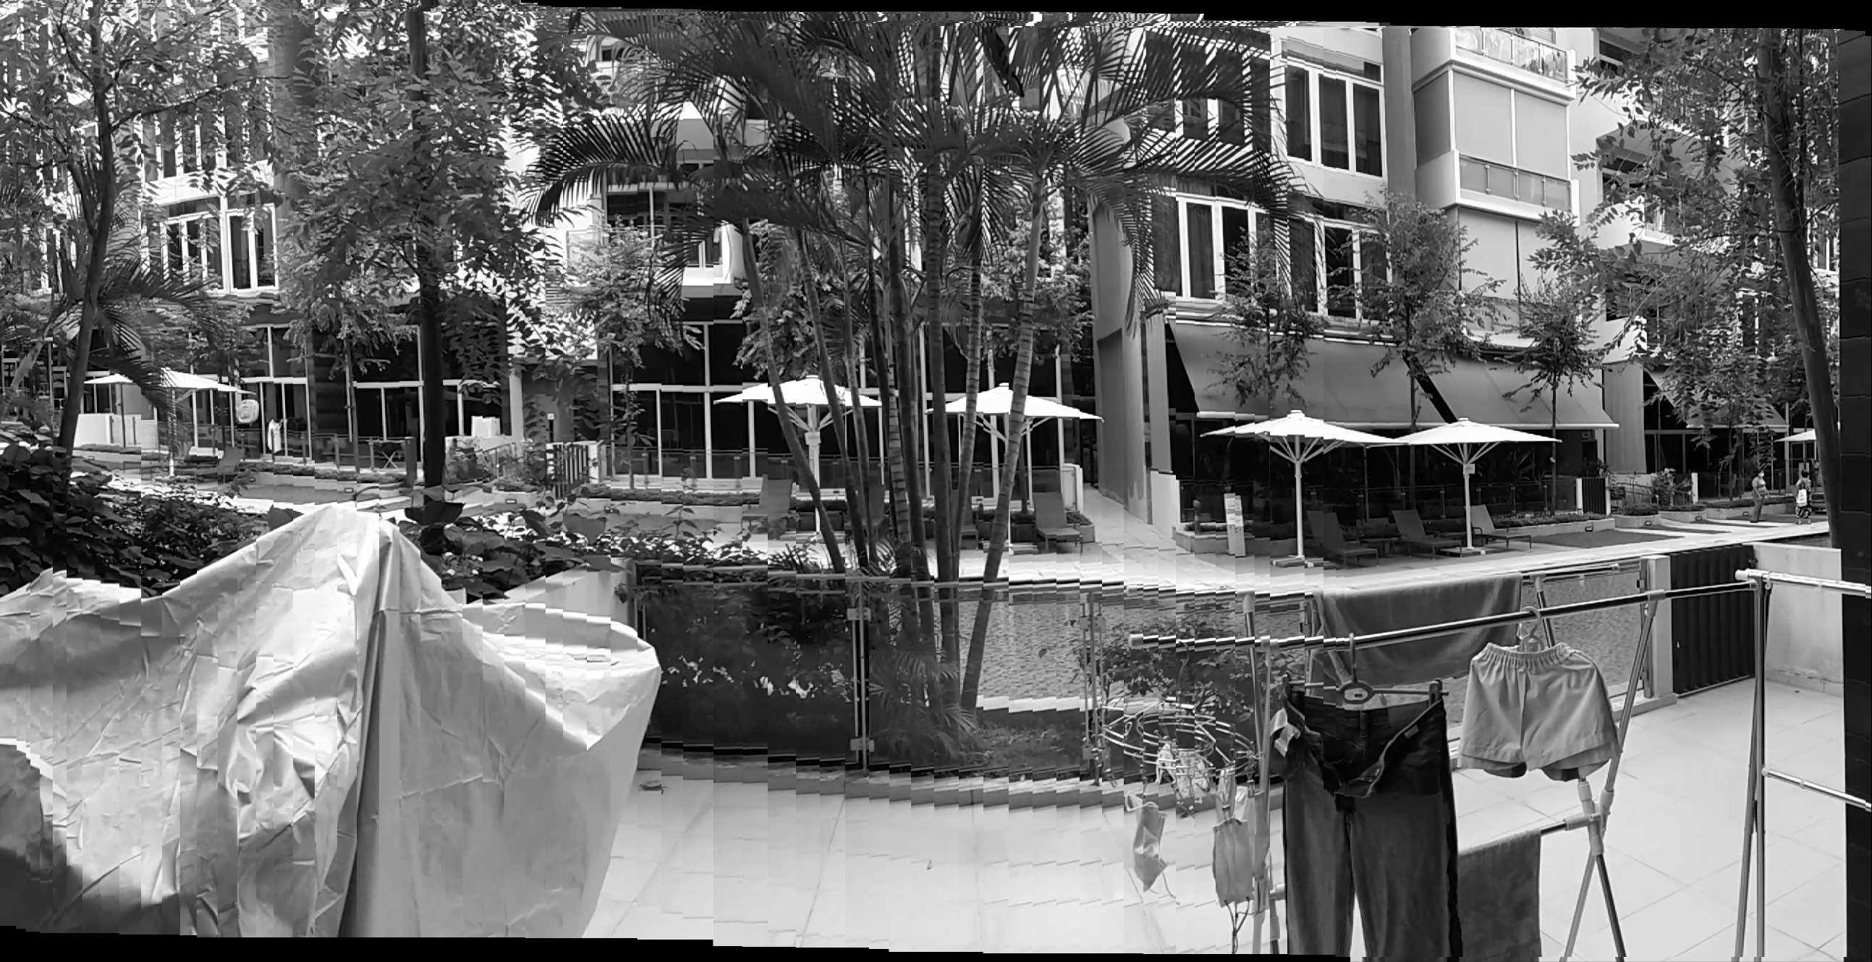
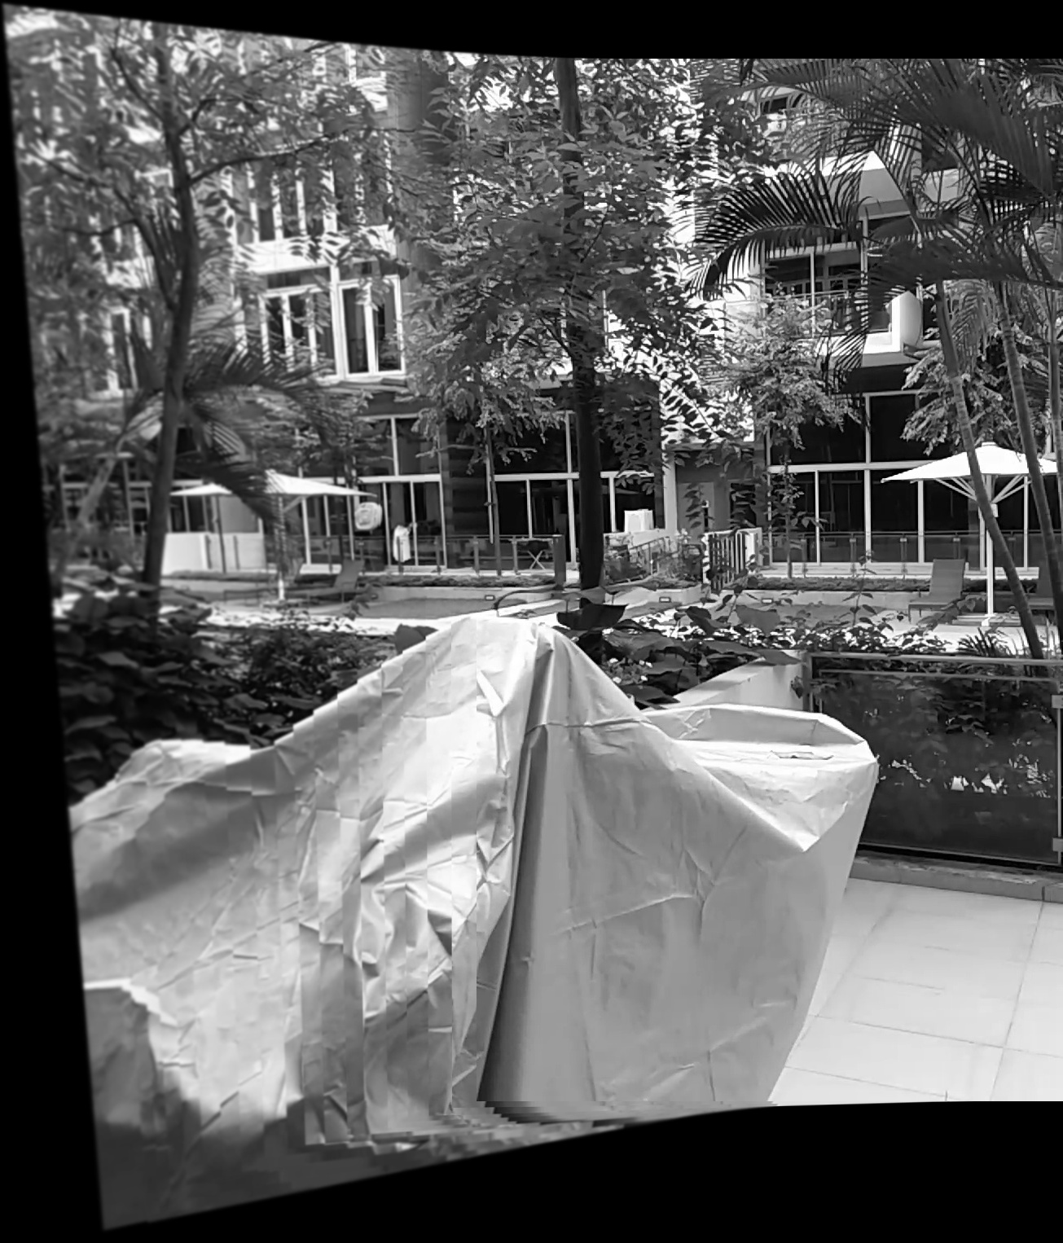
Other trials
use optical flow to estimate perspective transformation (workable for mouted camera, not working for hand held)
warp affine
warp perspective, heavily distorted at edge

Slide 12
Other trials
look deep into “stitch_detail.cpp” and “stitch_detail.py”
attempt to rewrite “pairwise feature matching” to “sequential feature matching” to save time
attempt to try different seam and blend algorithms

Slide 13
Other SDK to consider
Android's Camera Module (depriciated): Pano module and JNI C++ files
DJI's pano SDK
Huawei's pano SDK

Slide 14
Challenges
New to Java and Android development
time to get familar with C++ and JNI
stitching

